Slide 1
Unit -1
Introduction
[Chapter-1 & 2 from Forouzan]
Prachi Shah
IT Dept.
BVM

Slide 2
Content
Data Communication
Networks
Protocols and Standards
Standard Organizations
Line Configuration
Topology
Transmission Modes
Categories of Networks
OSI model & TCP/IP model
Example network: The internet, X.25, Frame Relay

Slide 3
1. Data Communication
Data & Communication
Why is Data Communication System Required?
Effectiveness of a Data Communication System:
Delivery
Accuracy
Timeliness
Jitter
Data Representation
Text Numbers Images | Audio Video

Slide 4
Data Communication
Components of data communication
(5)
(1)
(2) (3)
(4)

Slide 5
2. Networks
Data Communi-cation Network Criteria
Performance
Reliability
Security
Transit time
Response time
Throughput
Delay
Frequency of Failure
Unauthorization
Time taken by a link to recover
Networks robustness in catastrophe
Policy implementation for Recovery measures
Damage

Slide 6
3. Protocols & Standards
Protocols:
It is a set of rules that govern data communications.
It defines
what is communicated
how it is communicated
when it is communicated
Key elements of a protocol are:
Syntax (presentation or structure or format of the data)
Semantics (How a particular pattern is to be interpreted, and what action is to be taken)
Timing (when data should be sent and how fast they can be sent)

Slide 7
3. Protocols & Standards (Contd.)
Standards
De facto (By fact)
De jure (By law)

Slide 8
4. Standard Organizations
Standards Creation Committees formed by:
Forums (work with universities and users to test, evaluate, and standardize new technologies)
Regulatory Agencies (to protect the public interest by regulating radio, television, and wire/cable communications)
Internet Standards (It is a formalized regulation that must be followed)
Some Standards Creation Committees are:
International Organization for Standardization (ISO)
International Telecommunication Union-Telecommunication Standards Sector (ITU-T)
American National Standards Institute (ANSI)
Institute of Electrical and Electronics Engineers (IEEE)
Electronic Industries Association (EIA)

Slide 9
5. Line Configuration
Type of Connection
Point-to-Point
Multipoint

Slide 10
Point-to-Point Line Configuration

Slide 11
Point-to-Point Line Configuration

Slide 12
Point-to-Point Line Configuration

Slide 13
Multipoint Line Configuration

Slide 14
6. Topology
Physical Topology
Mesh
Star
Bus
Ring

Slide 15
Mesh Topology

Slide 16
Star Topology

Slide 17
Bus Topology

Slide 18
Ring Topology

Slide 19
Tree Topology

Slide 20
Hybrid Topology

Slide 21
7. Transmission Modes
Transmission Modes / Data Flow
Simplex
Half-Duplex
Full-Duplex

Slide 22
Example: Keyboards and traditional monitors
Simplex

Slide 23
Half-Duplex
Example: Walkie-talkies and CB (citizens band) radios

Slide 24
Full-Duplex
Example: Telephone network

Slide 25
8. Categories of Networks
LAN
(Local Area Network)
WAN
(Wide Area Network)
MAN
(Metropolitan Area Network)
Three Categories of Networks

Slide 26
Local Area Network

Slide 27
Local Area Network

Slide 28
Metropolitan Area Network

Slide 29
Wide Area Network

Slide 30
Internetwork
(Internet)

Slide 31
9.1
THE
OSI
MODEL

Slide 32

ISO is the organization. OSI is the model.

Slide 33
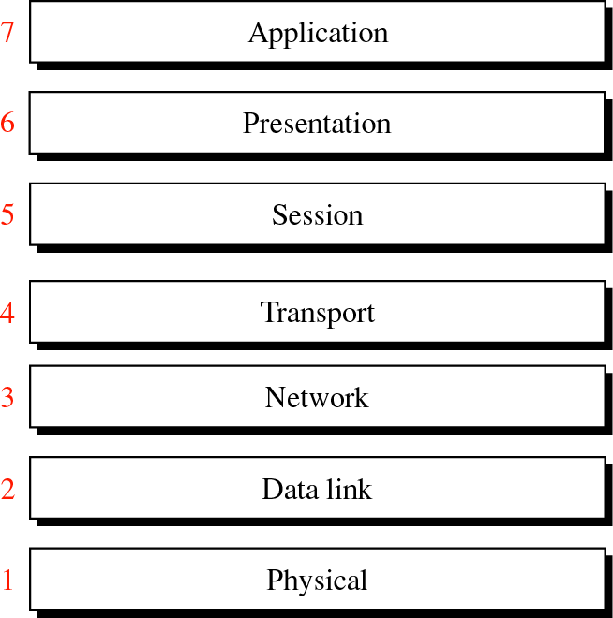
OSI Model

Slide 34
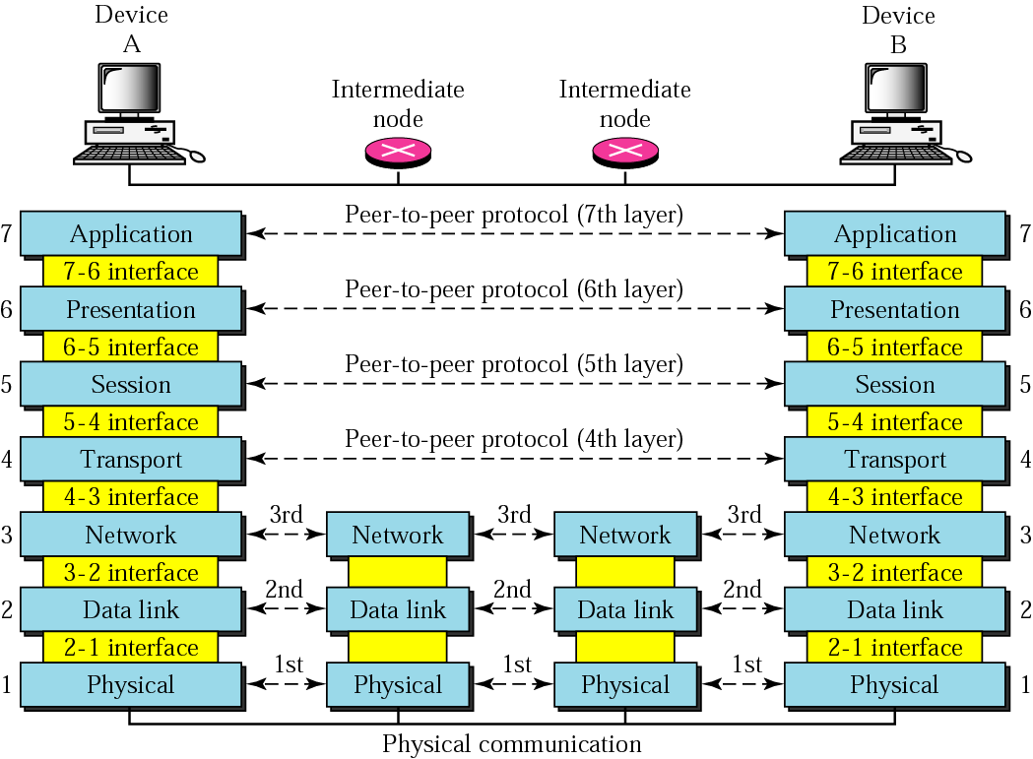
OSI layers

Slide 35
Headers are added to the data at layers 6, 5, 4, 3, and 2. Trailers are usually added only at layer 2.

Slide 36
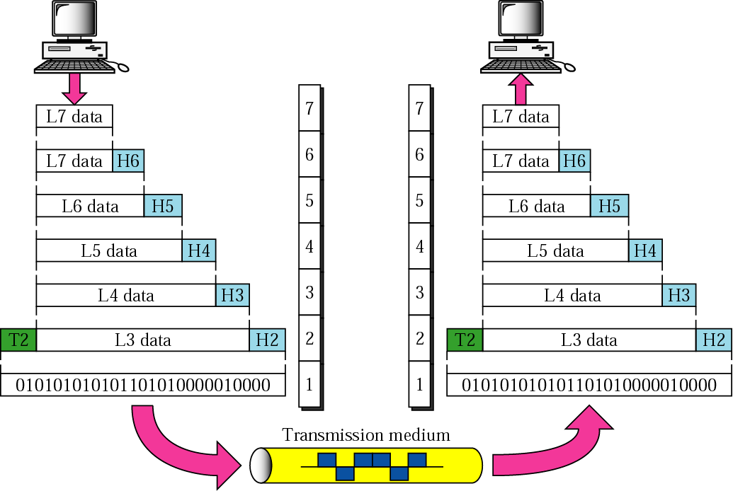
An exchange using the OSI model

Slide 37
LAYERS
IN
THE
OSI
MODEL

Slide 38
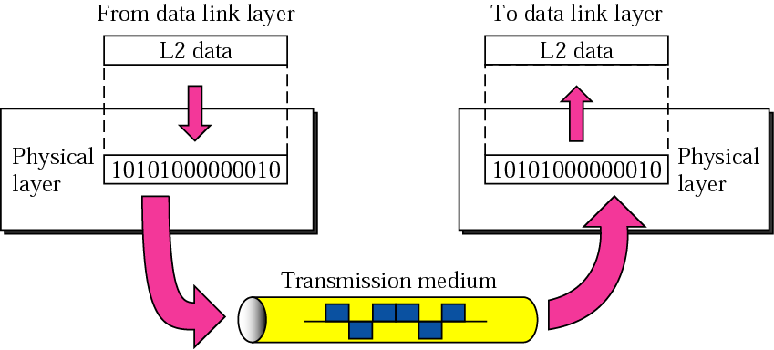
Physical Layer

Slide 39
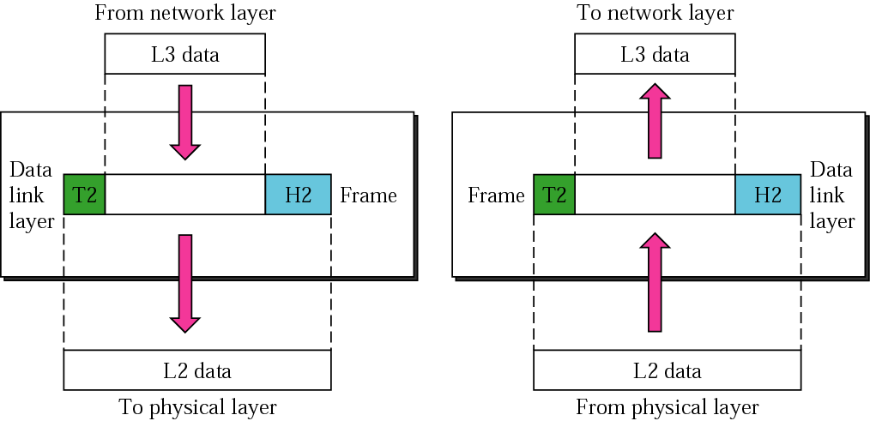
Data Link Layer

Slide 40
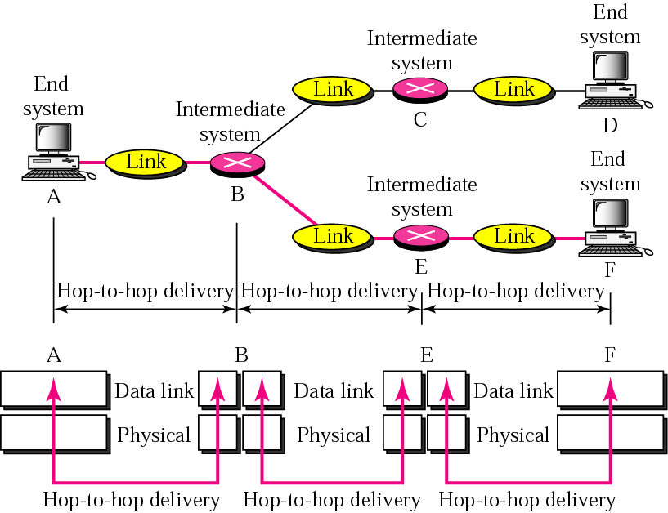
Node-to-node delivery

Slide 41
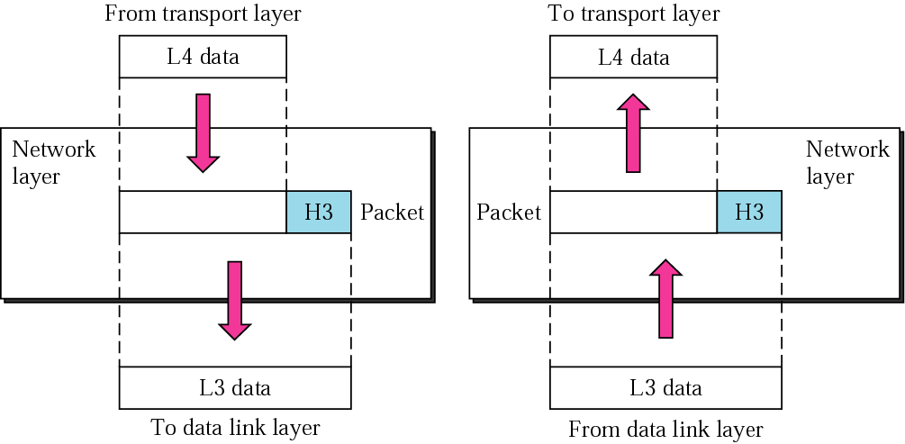
Network Layer

Slide 42
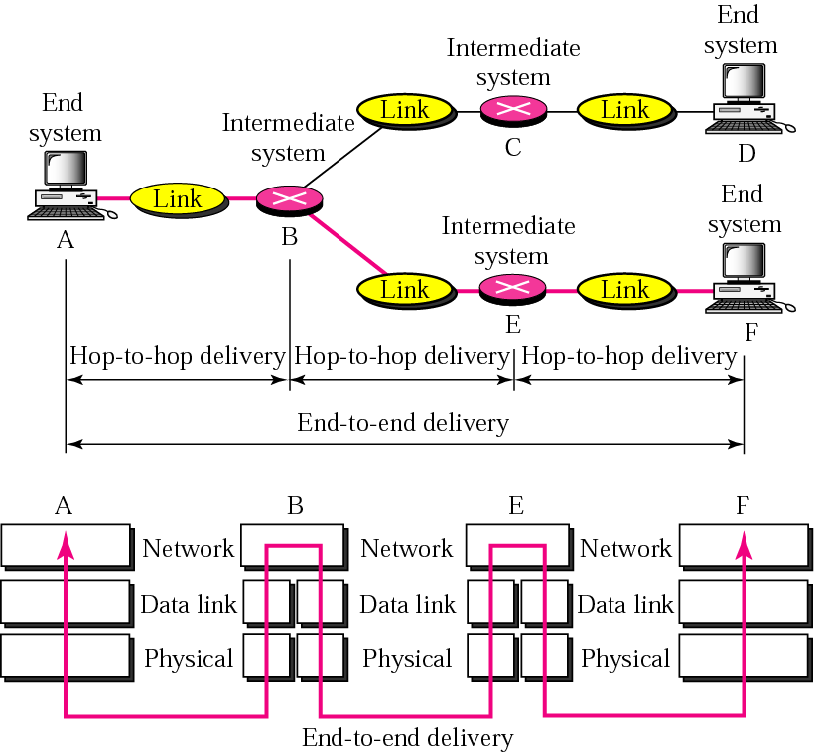
End-to-end delivery

Slide 43
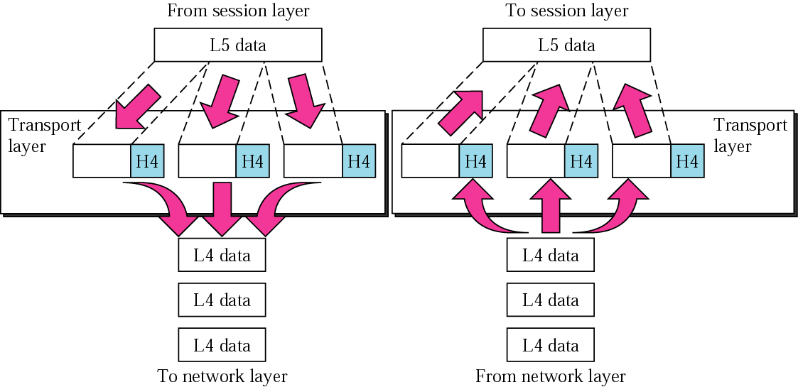
Transport Layer

Slide 44
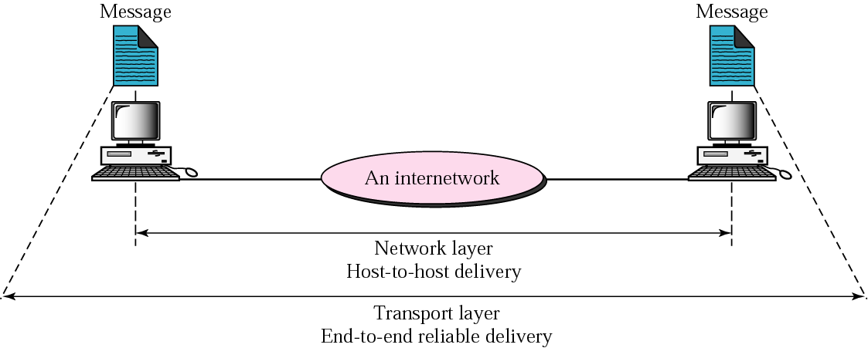
Reliable end-to-end delivery of a message

Slide 45
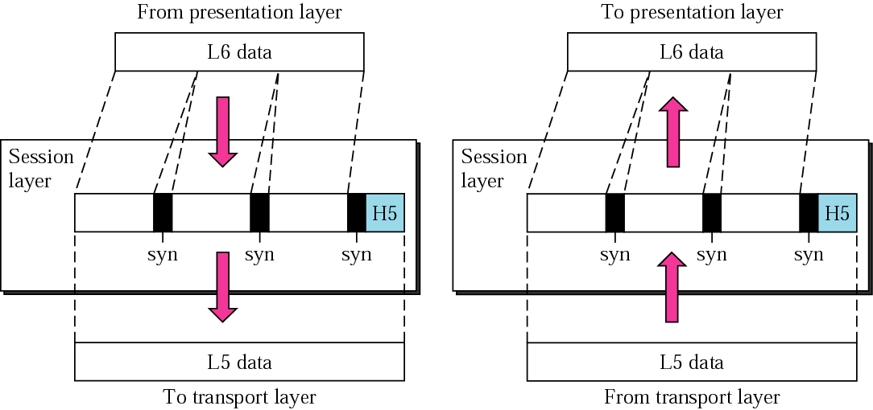
Session Layer

Slide 46
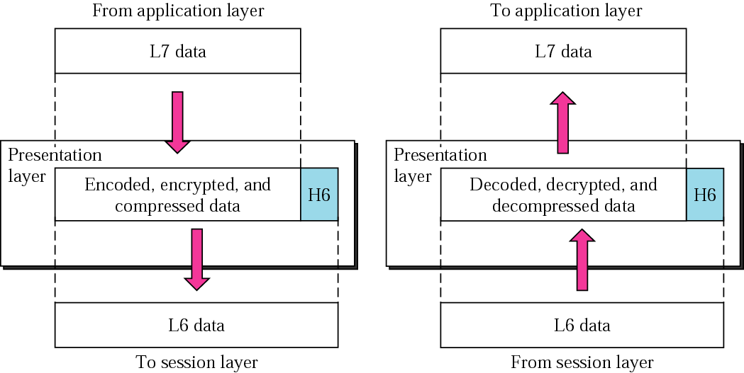
Presentation Layer

Slide 47
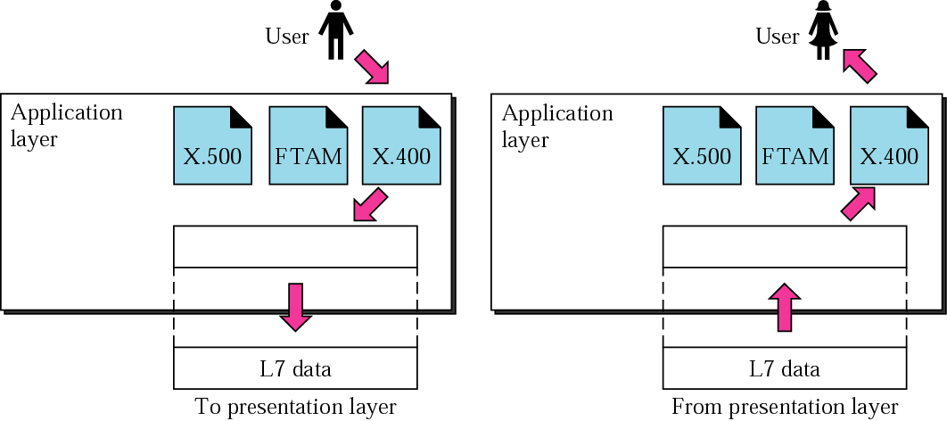
Application Layer

Slide 48
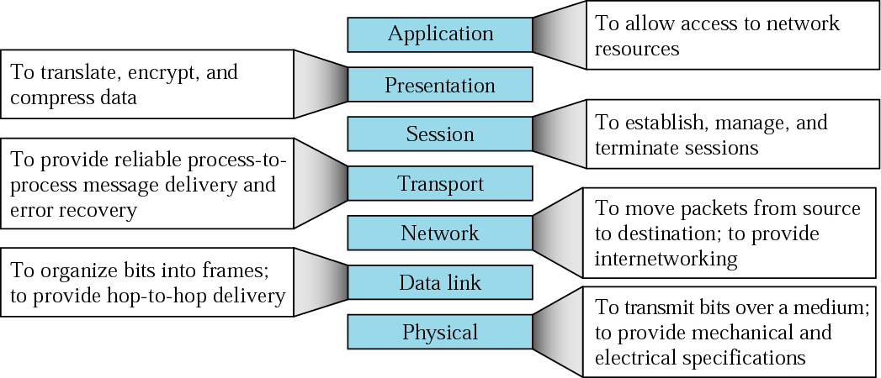
Summary of layers

Slide 49
OSI Model in Short

Slide 50
Connection Oriented Services | Connection Less Services
A connection is to be established before starting the communication | Each message is routed independently from source to destination
Authentication is needed | Does not need any authentication
Makes a connection and checks whether message is received or not and sends again if an error occurs | Does not guarantees a delivery
More reliable than connectionless service | Less reliable than connection oriented service
Connection oriented service interface is stream based | Connectionless service is message based

Slide 51
9.2
TCP/IP
PROTOCOL
SUITE

Slide 52
TCP/IP PROTOCOL SUITE
The layers in the TCP/IP protocol suite do not exactly match those in the OSI model.
The original TCP/IP protocol suite was defined as having four layers: host-to-network, internet, transport, and application.
However, when TCP/IP is compared to OSI, we can say that the TCP/IP protocol suite is made of five layers: physical, data link, network, transport, and application.

Slide 53
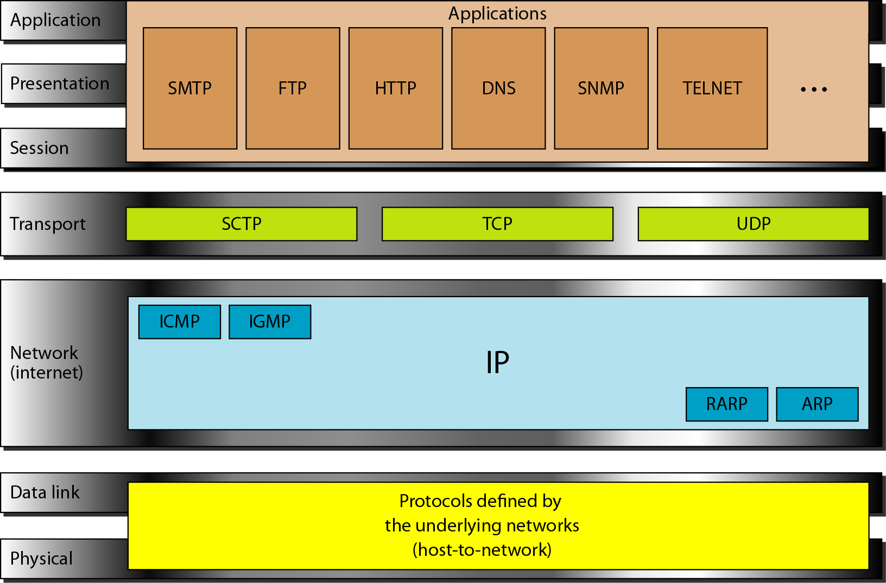
TCP/IP and OSI model

Slide 54
ADDRESSING

Slide 55
Addresses in TCP/IP
Addresses
Physical addresses
Logical addresses
Port addresses
Specific addresses

Slide 56
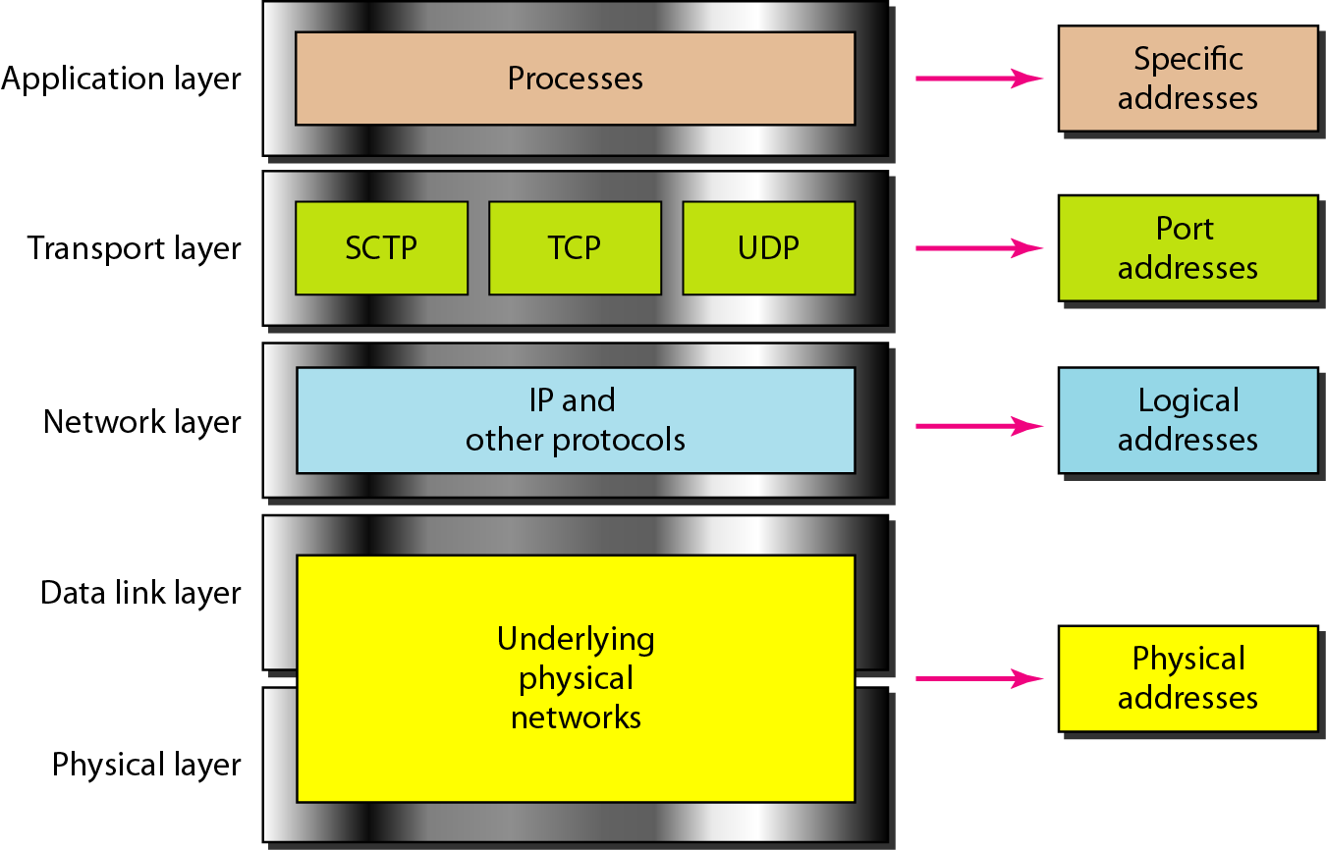
Relationship of layers and addresses in TCP/IP

Slide 57
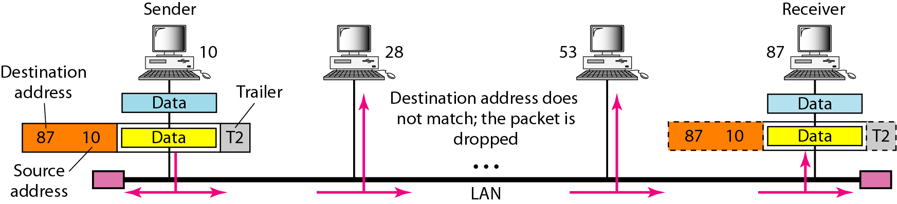
Example 1 - Physical addresses

Slide 58
Example 2
Most local-area networks use a 48-bit (6-byte) physical address written as 12 hexadecimal digits; every byte (2 hexadecimal digits) is separated by a colon, as shown below:
07:01:02:01:2C:4B
A 6-byte (12 hexadecimal digits) physical address.

Slide 59
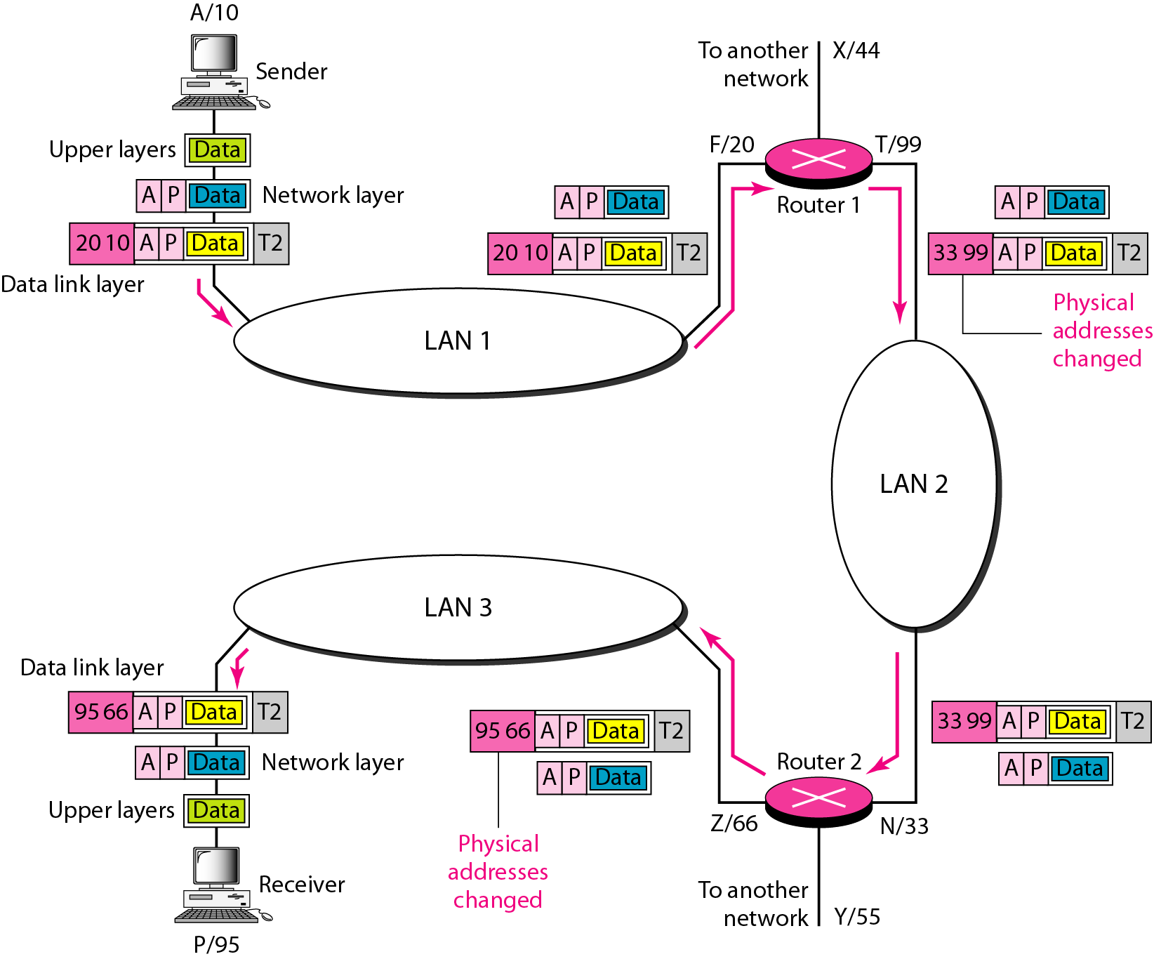
Example 3 IP addresses

Slide 60
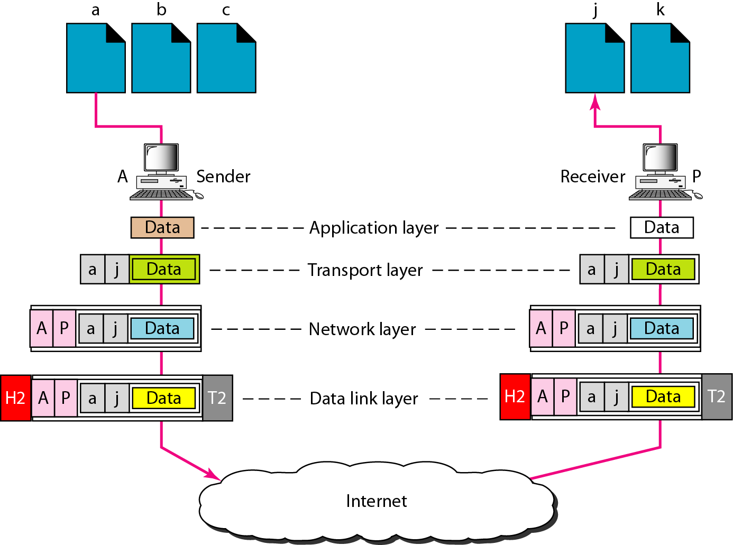
Example 4 Port addresses

Slide 61
A port address is a 16-bit address represented by one decimal number as shown.
Example 5
753
A 16-bit port address represented as one single number.

Slide 62
The physical addresses change from hop to hop, but the logical and port addresses usually remain the same.
Addresses | Address Length
Physical Address | 48 bits
Logical Address | 32 bits
Port Address | 16 bits

Slide 63
Specific Addresses:
Some applications have user-friendly addresses that are designed for that specific address.
Example : the e-mail address (for example, forouzan@fhda.edu) and the Universal Resource Locator (URL) (for example, www.mhhe.com).
The first defines the recipient of an e-mail
The second is used to find a document on the World Wide Web.
These addresses get changed to the corresponding port and logical addresses by the sending computer.

Slide 64
9.3 OSI v/s TCP/IP

Slide 65
10. Example Networks
Internet
X.25
Frame Relay

Slide 66
10.1) Internet
International ISP:
Connect nations
National ISP:
Backbone networks are connected by NAP (Network Access Points)
Regional ISP:
They are connected to one or more national ISPs
Local ISP:
They provide direct service to end users
Each local ISP can be connected to a regional or national ISP
It can be a
company providing Internet services
corporation with a network providing services to own employees
nonprofit organization like college or university running their own network

Slide 67
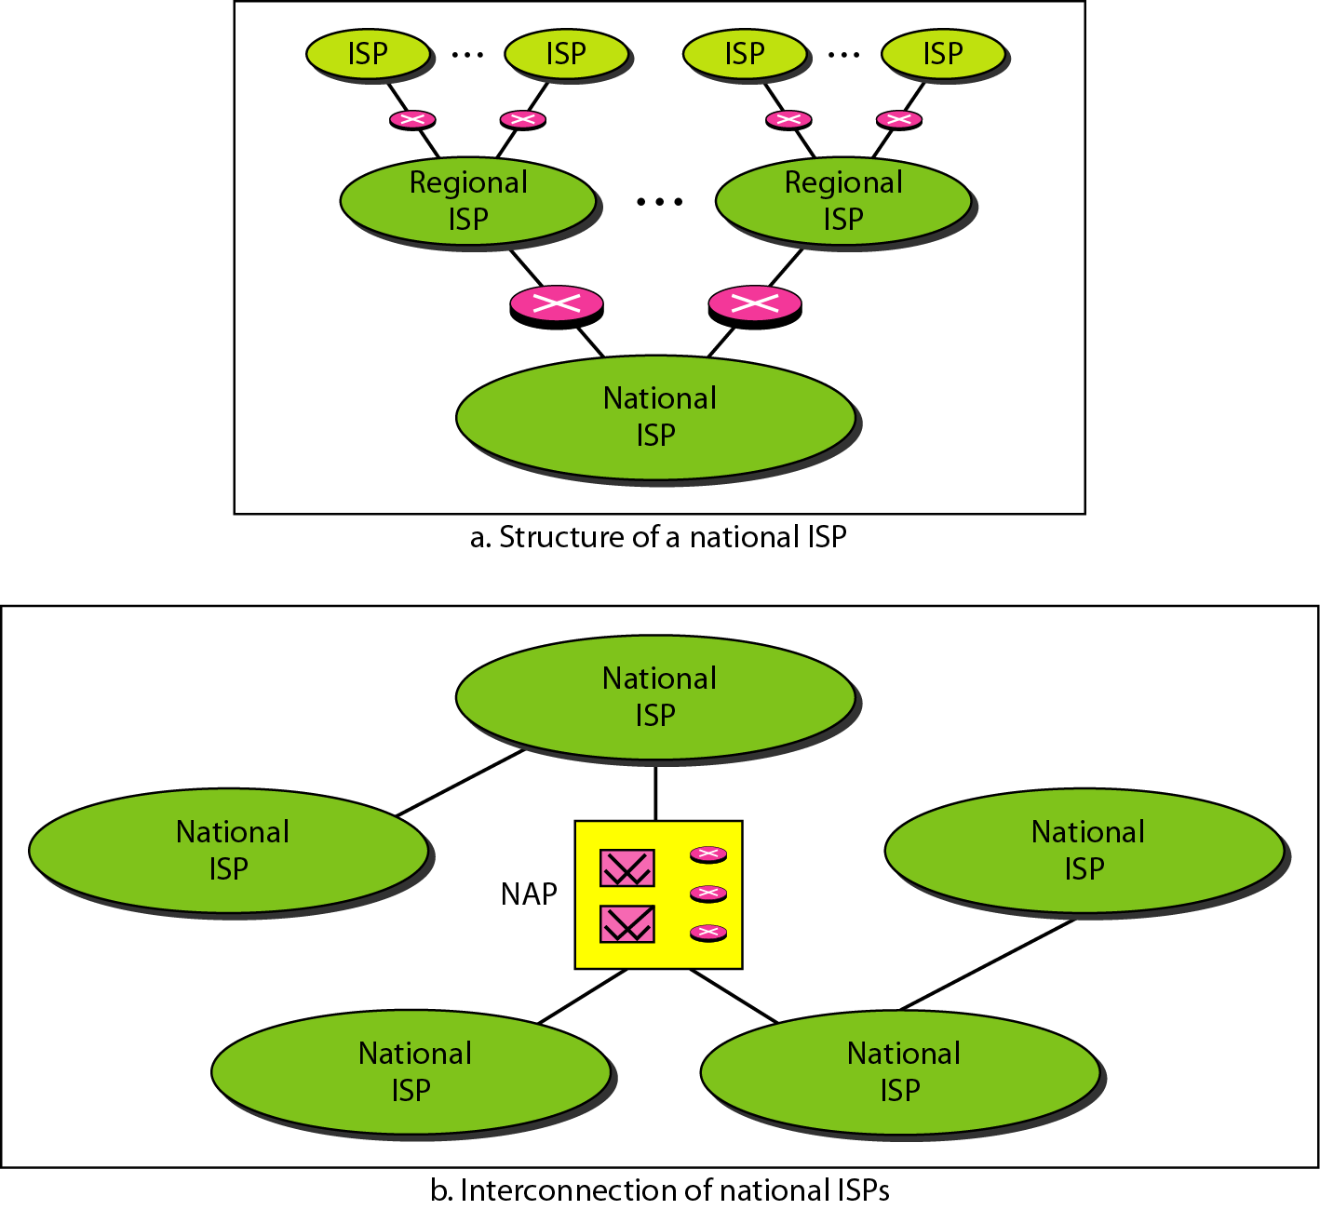
Hierarchical organization of the Internet

